Slide 1
Languages and Compilers
(SProg og Oversættere)
Lexical analysis

Slide 2
Lexical analysis
  Describe the role of the lexical analysis phase
  Describe lexemes and tokens
  Describe how a scanner can be implemented by hand
  Describe how a scanner can be auto-generated
  Describe regular expressions and finite automata and how they relate to implementations of scanners

Slide 3
Syntax Analysis: Scanner
Dataflow chart
Source Program
Stream of Characters
Scanner
Error Reports
Stream of “Tokens”
Parser
Error Reports
Abstract Syntax Tree

Slide 4
1) Scan: Divide Input into Tokens
An example ac source program:
f b
i a
a = 5
b = a + 3.2
p b
Lexems are “words” in the input, for example keywords, operators, identifiers, literals, etc.
Tokens is a datastructure for lexems and additional information
scanner
floatdl
id
intdcl
id
id
assign
inum
...
f
b
i
a
a
=
5
assign
id
plus
fnum
print
id
eot
...
=
a
+
3.2
p
b
Notes:
One token missing which?

Slide 5
1) Scan: Divide Input into Tokens
An example ac source program:
f b
i a
a = 5
b = a + 3.2
p b
Lexems are “words” in the input, for example keywords, operators, identifiers, literals, etc.
Tokens is a datastructure for lexems and additional information
scanner
floatdl
id
intdcl
id
id
assign
inum
...
b
a
a
5
assign
id
plus
fnum
print
id
eot
...
a
3.2
b

Slide 6
Implement Scanner based on RE by hand
Express the “lexical” grammar as RE
(sometimes it is easier to start with a BNF or an EBNF and do necessary transformations)
For each variant make a switch on the first character by peeking the input stream
For each repetition (..)* make a while loop with the condition to keep going as long as peeking the input still yields an expected character
Sometimes the “lexical” grammar is not reduced to one single RE but a small set of REs – in this case a switch or if-then-else case analysis is used to determine which rule is being recognized, before following the first two steps

Slide 7
Developing a Scanner
Express the “lexical” grammar in EBNF
Token ::= Identifier | Integer-Literal | Operator |
; | : | := | ~ | ( | ) | eot
Identifier ::= Letter (Letter | Digit)*
Integer-Literal ::= Digit Digit*
Operator ::= + | - | * | / | < | > | =
Separator ::= Comment | space | eol
Comment ::= ! Graphic* eol
Now perform substitution and left factorization...
Token ::= Letter (Letter | Digit)*
| Digit Digit*
| + | - | * | / | < | > | =
| ; | : (=|ε) | ~ | ( | ) | eot
Separator ::= ! Graphic* eol | space | eol

Slide 8
Developing a Scanner
Token ::= Letter (Letter | Digit)*
| Digit Digit*
| + | - | * | / | < | > | =
| ; | : (=|ε) | ~ | ( | ) | eot
private byte scanToken() {
switch (currentChar) {
case ‘a’: case ‘b’: ... case ‘z’:
case ‘A’: case ‘B’: ... case ‘Z’:
scan Letter (Letter | Digit)*
return Token.IDENTIFIER;
case ‘0’: ... case ‘9’:
scan Digit Digit*
return Token.INTLITERAL ;
case ‘+’: case ‘-’: ... : case ‘=’:
takeIt();
return Token.OPERATOR;
...etc...
}

Slide 9
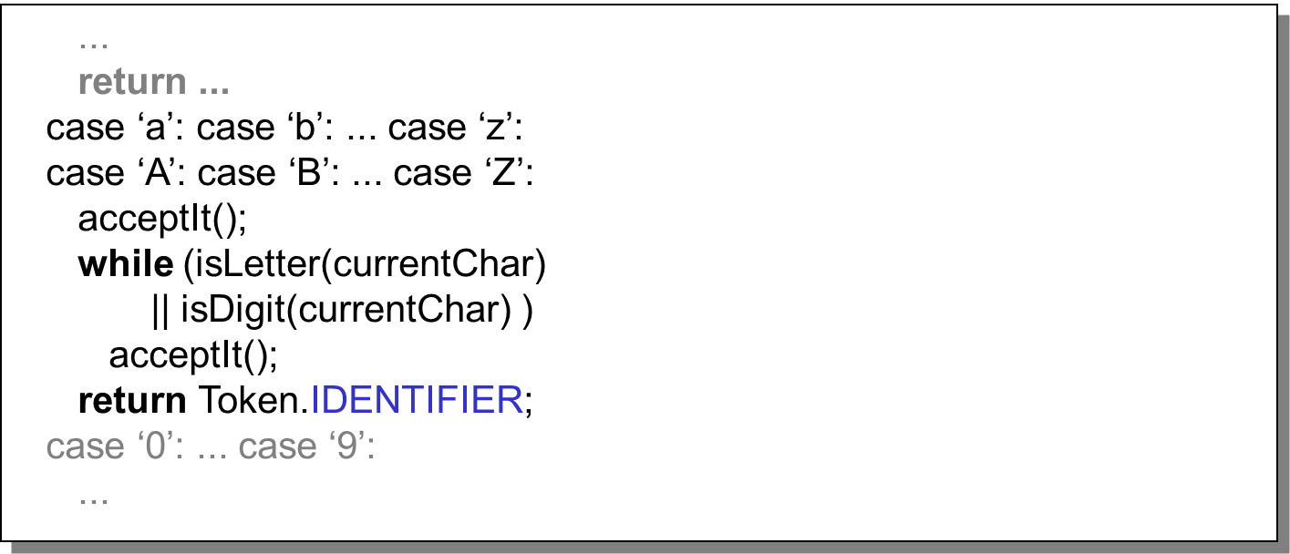
Developing a Scanner
Let’s look at the identifier case in more detail
Thus developing a scanner is a mechanical task.

Slide 10
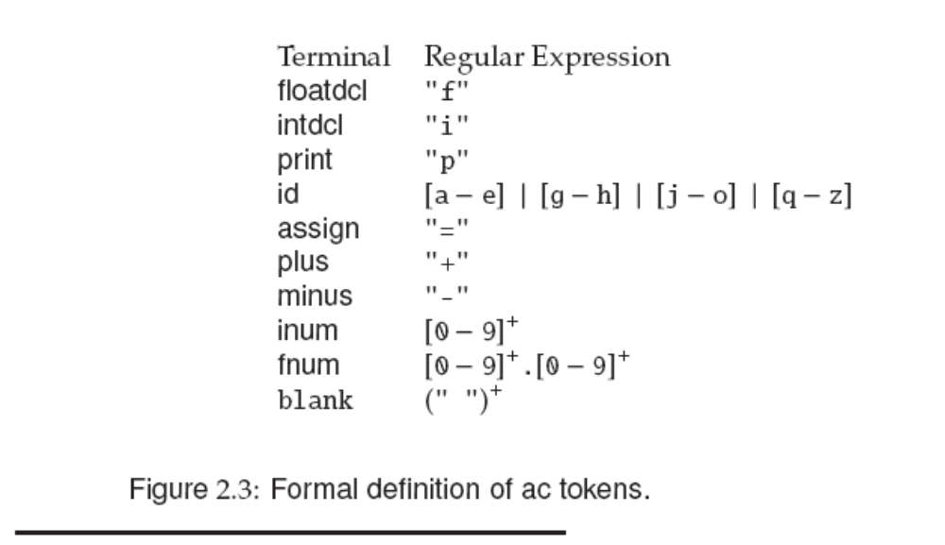
Token Specification
Notes:
Draw DFAs !

Slide 11
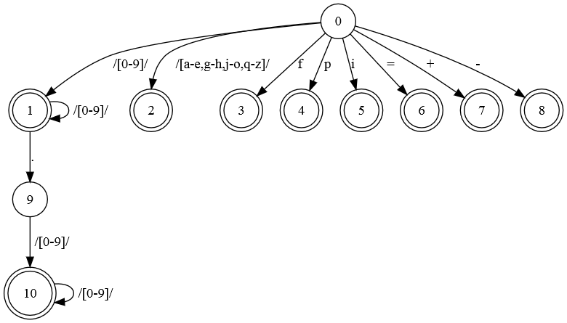
[0-9]+|[0-9]+.[0-9]+|[a-e,g-h,j-o,q-z]|f|p|i|=|\+|-

Slide 12
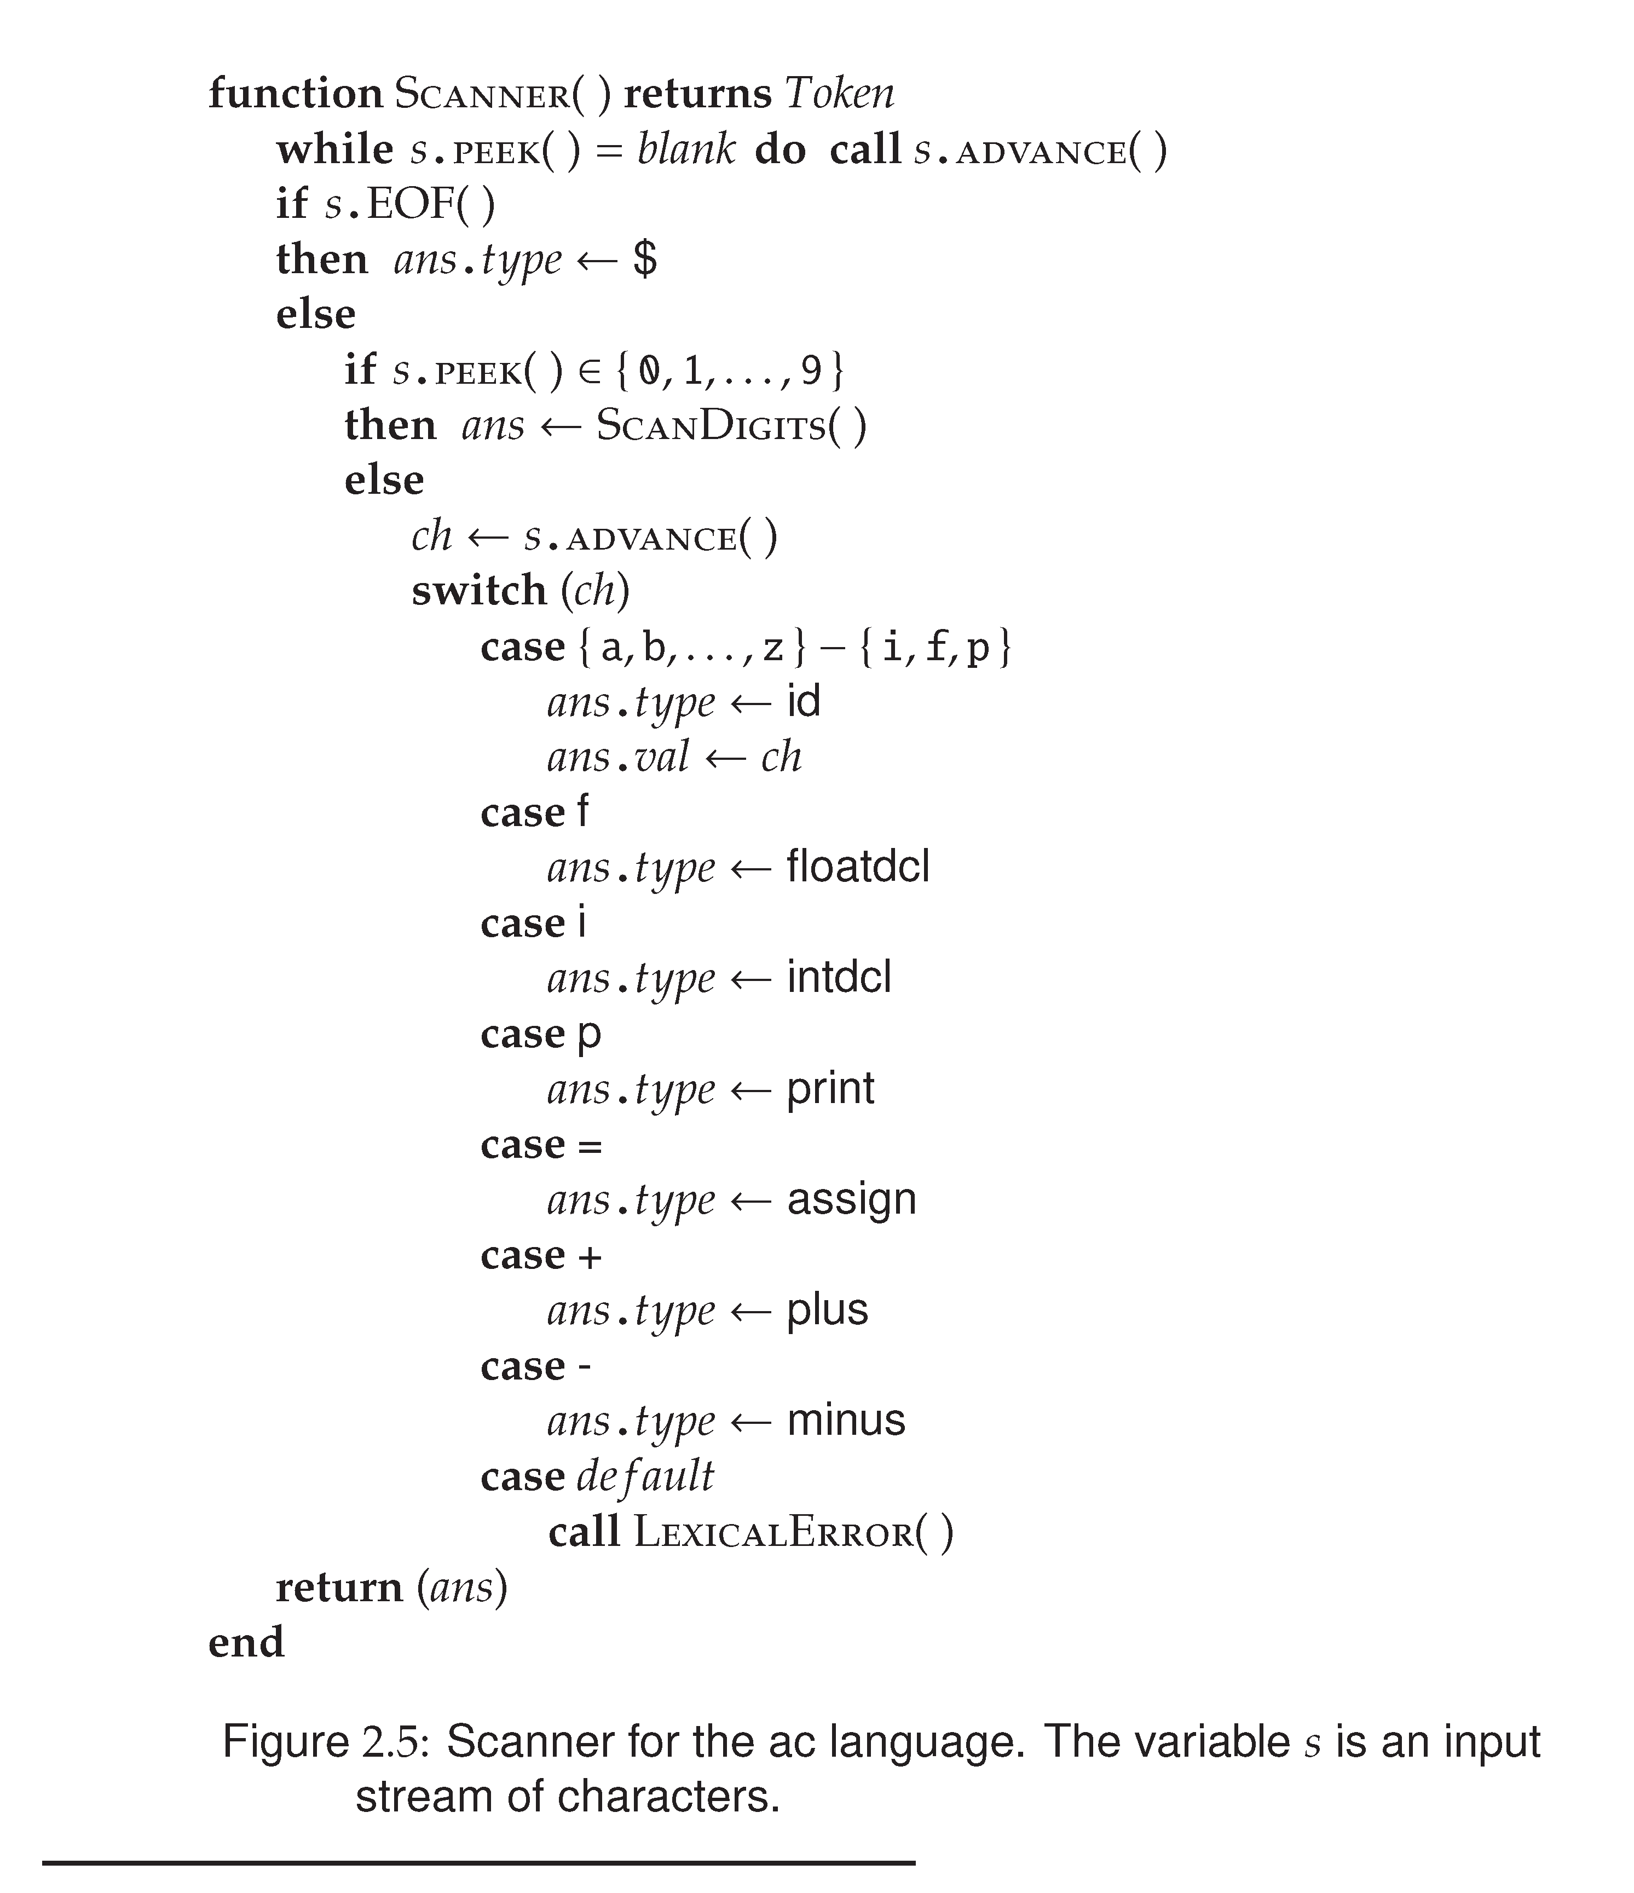

Slide 13
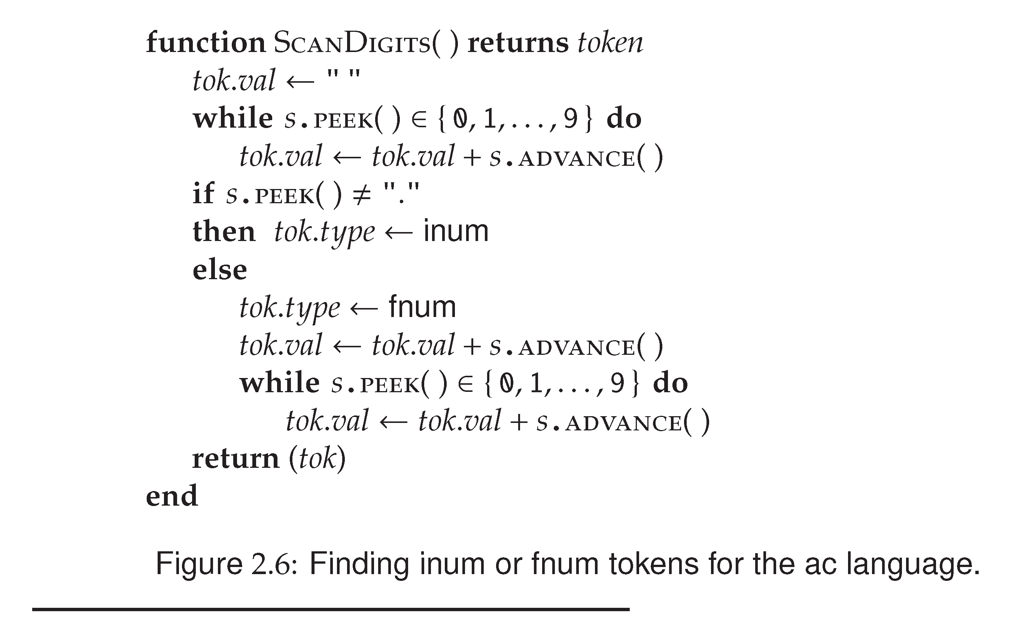
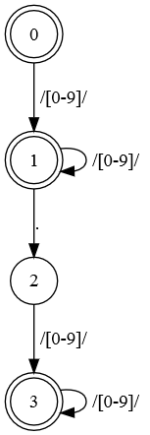
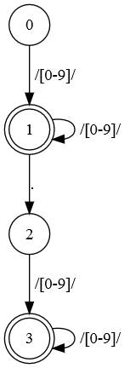
Notes:
Note: fejl is FA, der skal ikke være en tilstand efter . Da der teknisk set kan være tal uden decimaler e.g. 1.

Slide 14
Generating Scanners
Generation of scanners is based on
  Regular Expressions: to describe the tokens to be recognized
  Finite State Machines: an execution model to which RE’s are “compiled”
A possible algorithm:
- Convert RE into NDFA-ε
- Convert NDFA-ε into NDFA
- Convert NDFA into DFA
- generate Java/C/... code

Slide 15
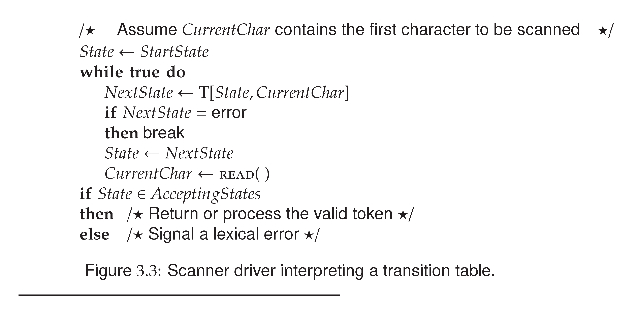
Implementing a DFA

Slide 16
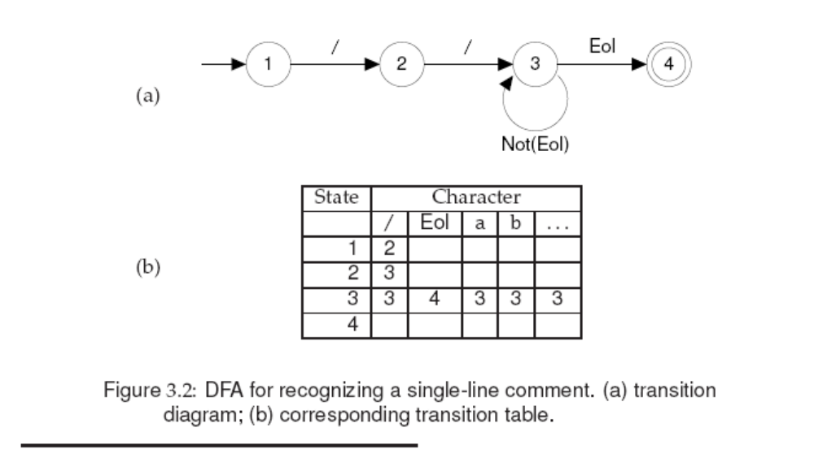
Comment -> //(Not(Eol))*Eol

Slide 17
Implementing a Scanner as a DFA
Slightly different from previously shown implementation (but similar in spirit):
  Not the goal to match entire input
  => when to stop matching?
      Token(if), Token(Ident i) vs. Token(Ident ifi)
    Match longest possible token
    Report error (and continue) when reaching error state.
  How to identify matched token class (not just true|false)
    Final state determines matched token class

Slide 18
Performance considerations
Performance of scanners is important for production compilers, for example:
  30,000 lines per minute (500 lines per second)
  10,000 characters per second (for an average line of 20 characters)
  For a processor that executes 10,000,000 instructions per second, 1,000 instructions per input character
  Considering other tasks in compilers, 250 instructions per character is more realistic
Size of scanner sometimes matters
  Including keyword in scanner increases table size
    E.g. Pascal has 35 keywords, including them increases states from 37 to 165
    Uncompressed this increases table entries from 4699 to 20955

